Slide 1
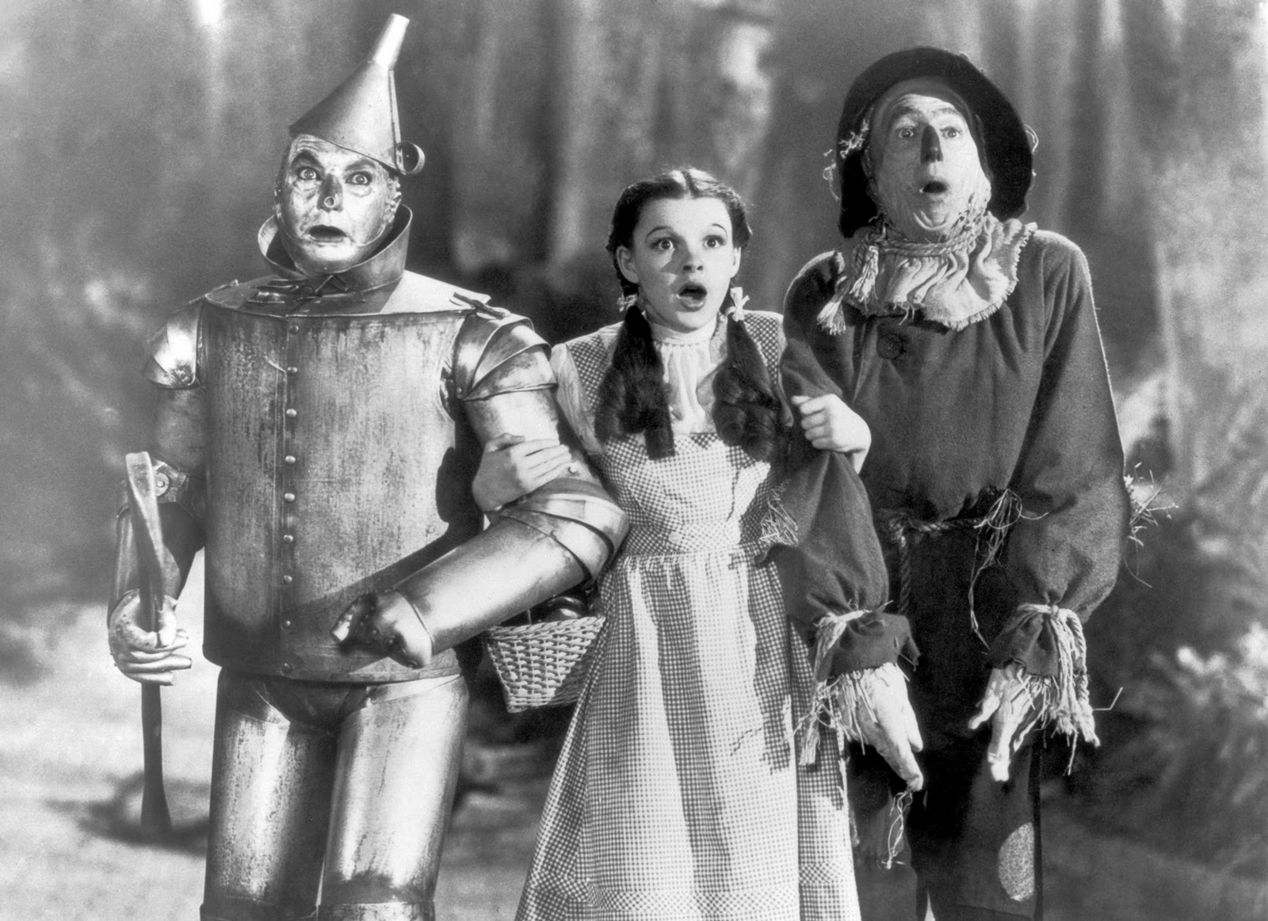
Arrays, Hashes, and Iteration – Oh My!

Slide 2
Overview
Ruby Tools
Arrays
Basics
Built in Methods and Documentation
Hashes
Basics
Built in Methods and Documentation
Iteration
Nested Data Structures

Slide 3

Learning Anything New Can Feel Like…

Slide 4
What Tools Are Already Available?

Slide 5

Understanding Our Building Blocks

Slide 6
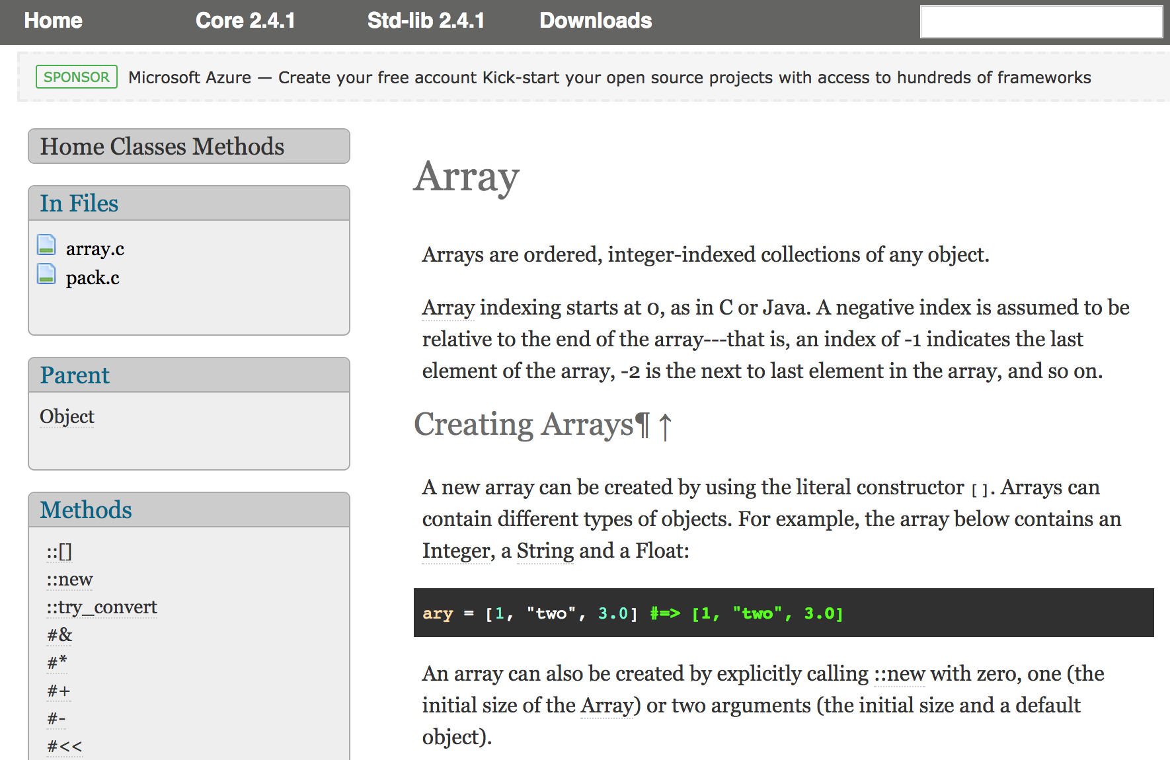
Class Name
Ruby Version
Class’ Parent
Class Methods (::)
Instance Methods (#)
Ruby Documentation - Classes

Slide 7
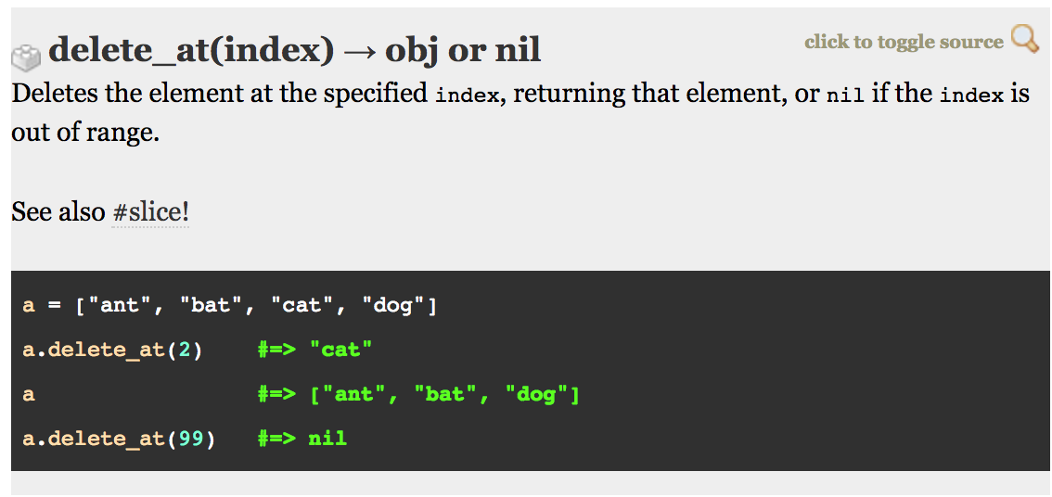
Parameter/Argument
Return Value(s)
Method Name
Explanation
Related Instance Methods
Examples
Ruby Documentation - Methods

Slide 8
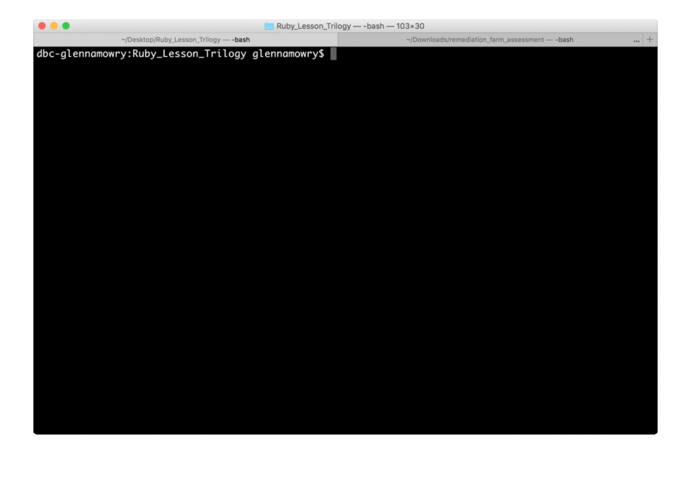
IRB - “Interactive Ruby”

Slide 9
Arrays

Slide 10
Array Basics
An ordered, integer-indexed collection of objects
Indexing starts at 0
Negative indices are relative to the end of the array, for instance: an index of -1 is the last object in the collection, -2 is the second to last
0 1 2 3 4 5

Slide 11
What do we use Arrays for?
Lists or collections of information
Queues for things like printer jobs, actions that need to happen
Query results from a database

Slide 12
Array Demo

Slide 13
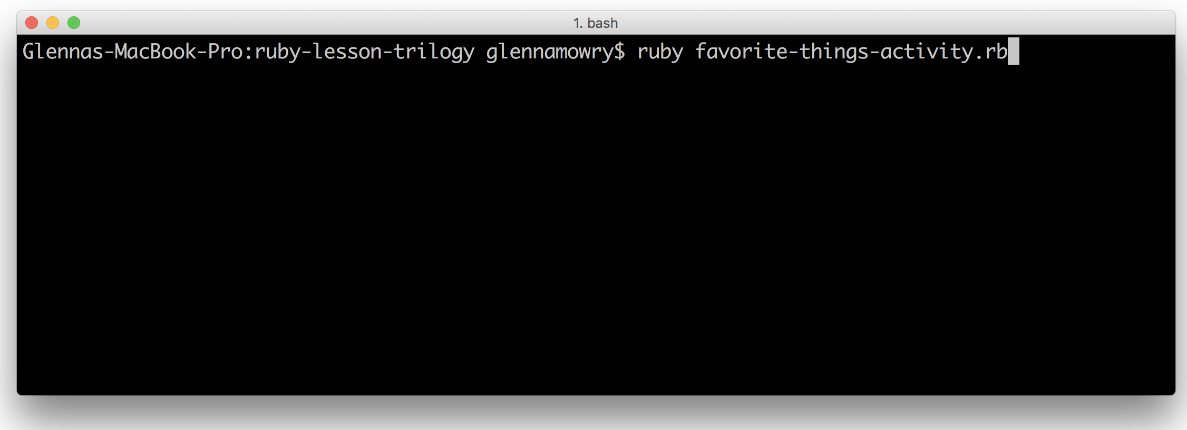
Your Turn! Code Dissection
With the file sent out to you via Slack, discuss with a partner what you expect to happen or to be returned in each section. Write your predictions before each section.
Run the file in your terminal/console by calling `ruby favorite-things-activity.rb` in the directory you save it in to see if your predictions were correct.

Slide 14
Hashes

Slide 15
Hash Basics
A dictionary-like object containing key and value pairs
Keys are unique
Enumerate their objects in the order they were inserted
Key
Value
Key
Value

Slide 16
What do we use Hashes for?
Storing relational data – for instance, how much information does Facebook know about you on your profile: name, birthday, location, job history, education, relationships, etc.
Database results: column name as the key and data for a specific row for a value

Slide 17
Hash Demo

Slide 18
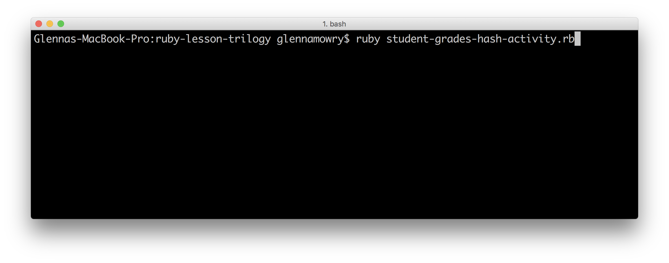
Your Turn! Code Dissection
With the file sent out to you via Slack, discuss with a partner what you expect to happen or to be returned in each section. Write your predictions before each section.
Run the file in your terminal/console by calling `ruby student-grades-hash-activity.rb` in the directory you save it in to see if your predictions were correct.

Slide 19
Your Turn! Data Structures Activity
We'll be practicing determining what type of data structure is best for the given information and data.
Work with a partner to complete this activity.
Download the file sent to you via Slack and follow the instructions in the file.

Slide 20
Instance/Built-In Methods

Slide 21
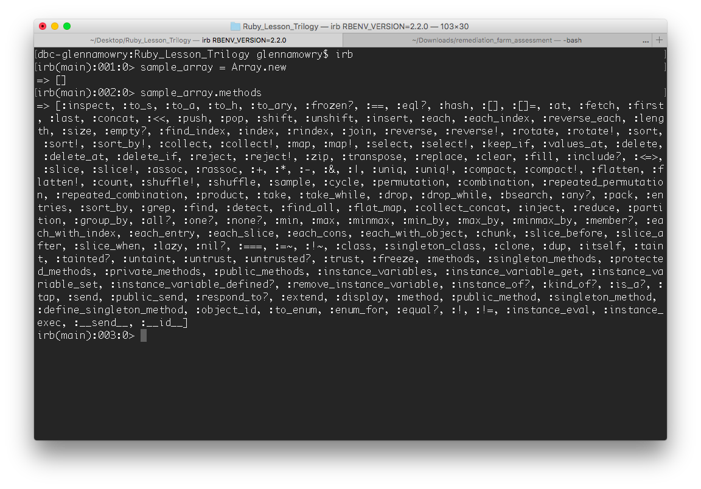
Array Methods

Slide 22
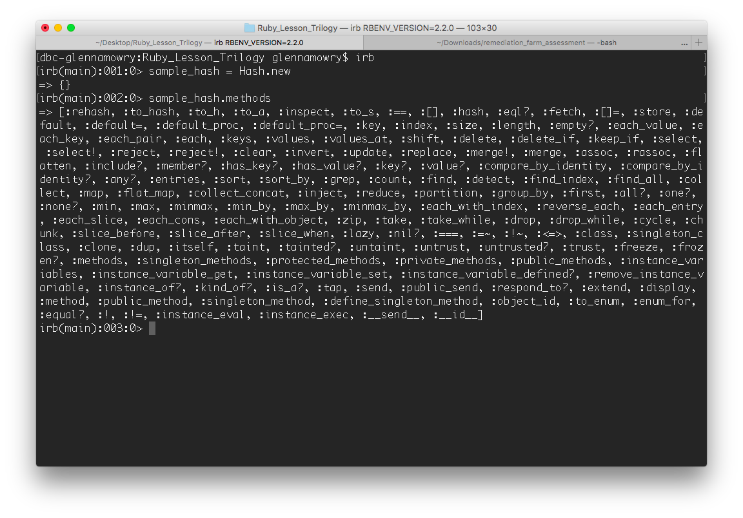
Hash Methods

Slide 23
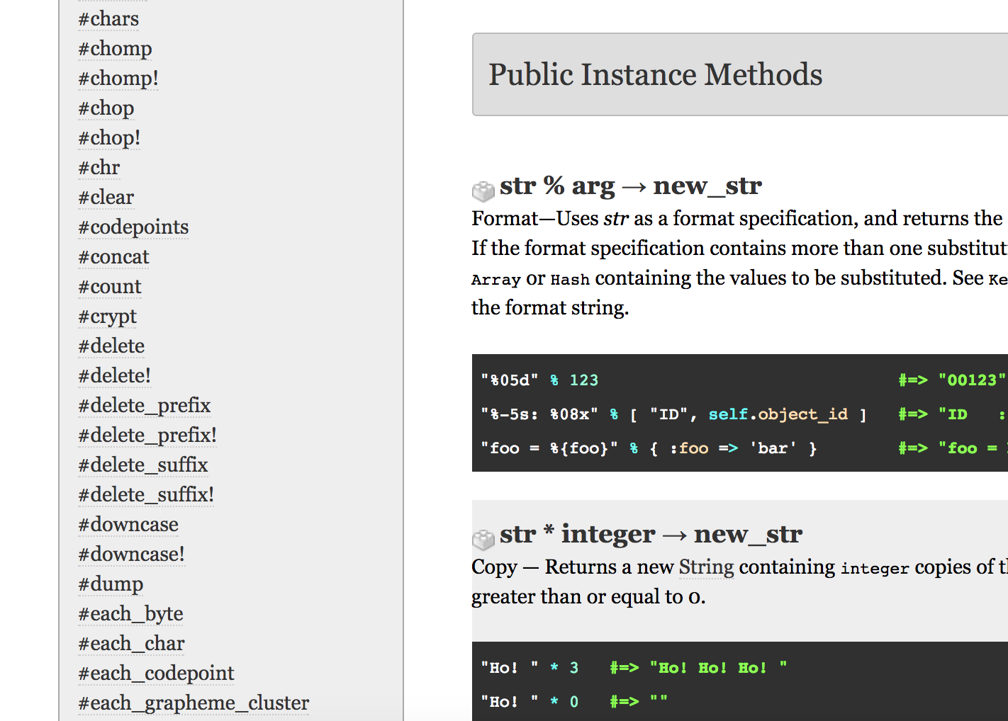
Instance Methods
Instance methods are those that are defined with the definition of the class itself in Ruby, like all methods for the Array Class or Hash Class
They are available to all instances of that object - so any Array you create, you can call one of the Array instance methods on it

Slide 24
Instance Methods Demo

Slide 25
Your Turn! Instance Methods Activity
Complete the prompts and questions in the file by finding the appropriate instance method in the Ruby docs.
Experiment with the instance method in IRB so you are positive you found the accurate method before adding it to your solution.
When finished, turn to a partner and discuss what you found difficult about finding a specific instance method in the documentation.
Don’t forget to use the docs! http://ruby-doc.org/

Slide 26
Iteration

Slide 27

Iteration
To perform repeatedly
In the context of Ruby, we will repeatedly go through each item/key-value pair/object in a data type or structure
Can use different tactics but common ones are:
`for` loops
`each` Enumerable method
`times` Integer method with length of data type/structure

Slide 28
Iteration Demo

Slide 29
Your Turn! Iteration Activity
Download the file sent out via Slack.
With a partner, write Ruby code that completes the iteration drills for the array and hash examples.
Bonus: Once you complete all of the iterations, go back and try to redo them using a different type of iteration. If you used `.each` the first time, try it with a `for` loop!

Slide 30
Nested Data Structures

Slide 31
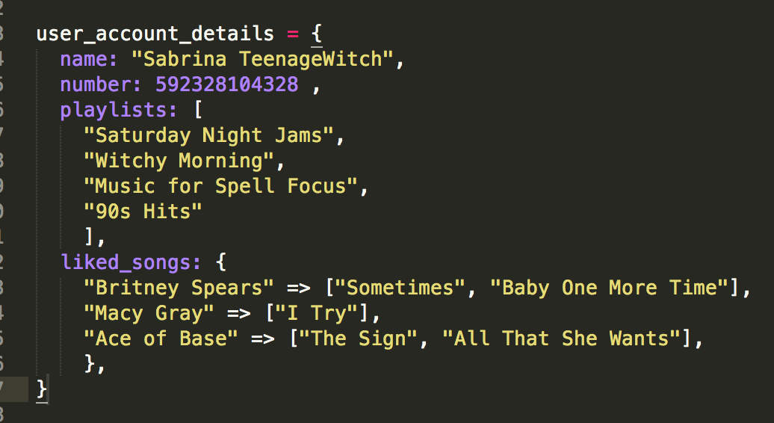
Nested Data Structure

Slide 32
Why use Nested Data Structures?
Consolidate information and assign it to one variable
Allow flexibility in the way we store related but different types of data
Most data sent isn’t so simple anymore– there is a lot to keep track of!

Slide 33
Nested Data Structures Demo

Slide 34
Your Turn! Nested Data Structures Activity
Download the file sent out via Slack
With a partner, complete all of the prompts in the activity.

Slide 35
Questions?

